Slide 1

Federal Health Architecture
Architecture and Modeling WG Meeting
FHA Information Modeling (IM) Project
July 31, 2012

Slide 2

Agenda
Overview of Information and Associated Terminology Models
Overview of Implementation Modeling Tools
Demonstration of Prototype
How the Models/Tools Support the S&I Framework
Summary and Discussion
Presenters
  Steve Wagner - FHA Program Manager
  Sean Muir - OHT MDHT Developer

Slide 3
Federal Health Information Model (FHIM) and Associated Terminology Models
Goal
  Produce a logical, health information model that supports semantic interoperability and that is built by harmonizing information from the individual Federal partners and standards organizations
Developed using a standard process and style guide
  Lead FHIM modeler ensures consistency, integration and harmonization across domain models
  Health information divided into domains (e.g., Person, Laboratory, Medications/Pharmacy, etc.) - each domain has a modeling team
    Modeling team consists of lead modeler, SMEs, Federal partner liaisons, others
  Model each domain starting with existing information from baseline model
  Incorporate and harmonize information from Federal partners
  Incorporate and harmonize information from standards organizations
Model is versioned and stored in a GForge repository as it is developed

Slide 4
Benefits of Information Modeling Project Information and Terminology Models
The models retain use case context
The models are integrated (2-way links between Information Terminology models)
The modeling process harmonizes content (information and terminology) across federal partners and SDOs
The models support efficient standards development
The models are being integrated with the MDHT to support a model-driven approach to development of information exchange interoperability specifications
The models can be leveraged by organizations for internal use in systems and database development
The models are developed using standard UML

Slide 5
Federal Health Information Model (FHIM) and Associated Terminology Models
HL7 Reference Information Model (RIM) used as a reference model for the FHIM (can also use other reference models)
FHIM links to terminology models/value sets by storing a unique value set ID
Terminology models maintain all other terminology information
FHIM maintains traceability to use cases and the HL7 EHR-S Functional Model
FHIM incorporates information from Computational Independent Models (CIMs)
FHIM is a Platform Independent Model (PIM)

Slide 6
Federal Health Information Model (FHIM) and Associated Terminology Models
Modeling priorities for the FHIM are set by a Managing Board of federal partners
FHIM priorities include full support for information domains specified by Clinical Care Document (CCD) and Meaningful Use
Eleven Federal partners are participating directly in the Information Modeling (IM) Project (VA, DoD, FDA, CDC, NCI, HHS, CMS, IHS, SSA, SAMHSA and NLM)
All other Federal partners have the opportunity to participate through model reviews/feedback

Slide 7
Overview of Model-Driven Health Tools
Open source project within Open Health Tools (OHT)
Based on Eclipse Platform - template driven and extensible
First tooling release in Jan 2011 targeting full-lifecycle support for CDA; version 1.1 released May 2012
  UML design of implementation guides
  Publishing ballot specs and developer docs
  Generating validation and Java runtime support
Prototype completed using non-CDA base models (e.g. FHIM, NIEM core, NCPDP) in MDHT tooling and generating XSD implementation, in addition to Java
Can generate multiple implementation (PSM) models
Three user roles of MDHT apply to CDA and other base models

Slide 8
MDHT Project Benefits for Three Users Roles
Standards organizations
  Formalize representation of implementation guide conformance rules
    Replace current practice of using MS Word for specification development
    UML specification is testable for consistency and use of best practices
    Enables automated model-driven development and code-generation
  Automate publication of implementation guides in multiple formats (PDF and XHTML) and alternative content structure (ballot document vs. implementer view)
  Automate generation of XML instance validator from specification model (using Java and OCL)
Business Analysts
  Consistent format of published implementation guide between different standards organizations (HL7, IHE, HITSP, Consolidated CDA)
  Cross-referenced, hyperlinked reference material accelerates analysis and EHR mapping
  Publish a “developer view” of implementation guide that combines conformance rules from all inherited templates and base core model type
Implementers
  Reduce Development Cost: Time and resources for analysis and implementation of content and conformance rules
  Reduce Maintenance Cost: High quality, domain-specific API for programmatic access to model content, and validating conformance with standard implementation guide rules (e.g. CCD, HITSP C32/C83 and Consolidated CDA)
  Future support planned for non-Java implementation languages (e.g., C#)

Slide 9
Publishing and Validation
Publishing Implementation Guides, Normalized Format
  The UML models created with template definitions are automatically transformed to DITA XML (OASIS standard), which is then published to PDF and HTML formats
  Developer documentation includes the complete aggregate list of all inherited elements and conformance rules. Thus, a developer does not need to "follow the breadcrumbs" of template conformance references. This issue is #1 complaint by developers using HITSP and IHE specifications
Validating XML Instances
  Conformance rules modeled in UML are transformed to Object Constraint Language (OCL) expressions that are executed by the Java runtime
  Enables rapid iterative development of specification and conformance test suite

Slide 10
CDA Models and Reference Implementations
MDHT team is currently working on UML models and Java implementations of the following CDA-based document types:
  HL7 Consolidated CDA Guide
  HL7 Continuity of Care Document (CCD)
  IHE Patient Care Coordination (PCC) Profiles
  HITSP C83 and C32 Patient Summary
  HL7 Public Health Case Report (PHCR)
  IHE Lab Report Document
  HITSP C74 Personal Health Monitoring Report
  HL7 Health Story specifications (CDA Common Data Types)
  And Others
Second generation prototype of NIEM implementation

Slide 11
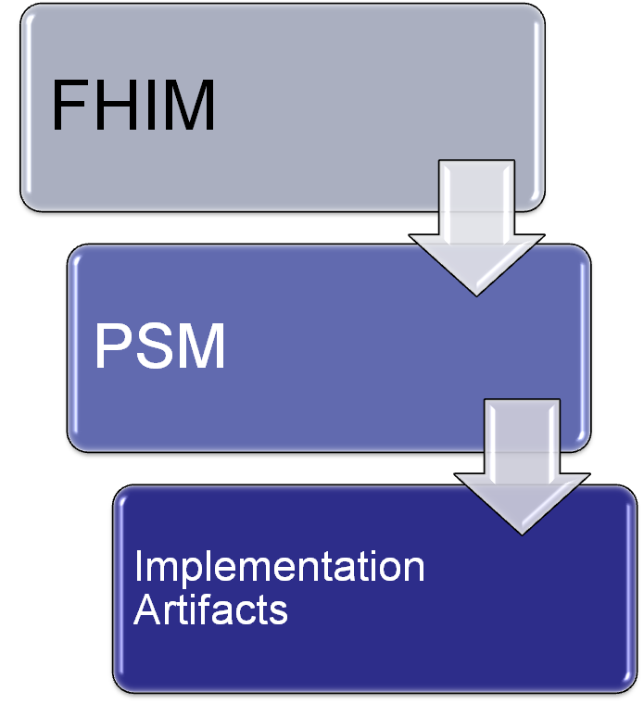
FHIM Conformance Considerations
CIM 1
CIM 2
CIM n
Conformance to a FHIM domain is validated by verifying conformance to a specific technology implementation

Slide 12

FHIM Model
(PIM)
1
FHIM Model Driven Prototype
Approach
NIEM Health Domain
Harmonized
Uses
Lab Domain Integration Use Case
Constrains
2
Uses
Platform Independent
Lab Domain Exchange (PIM)
Platform Specific
MDHT
4
Transform
5
OMG/NIEM
CDA Exchange PSM (UML)
NIEM Exchange PSM (UML)
8
Generate
6
Transform
Generate
9
Transform
7
CDA Implementation Guide Document
CDA Exchange Implementation and Rules
(Java)
NIEM Exchange PSM Implementation Structure and Rules
(XSDs)
NIEM IEPD
Document

Slide 13
Prototype Demonstration
5

Slide 14












Mapping of Models and Tools to S&I Framework
IM Project Models and Tools
Information and Terminology Modeling
Implementation Modeling
Standards Development
Pilot Demonstration Projects
Use Case Development
and Functional Requirements
Harmonization of
Core Concepts (NIEM framework)
Implementation Specifications
Reference Implementation
Certification
and Testing
Scenario
Planning
NIEM IEPD Lifecycle

Slide 15
How the Models/Tools of the IM Project Support the S&I Framework
Direct engagement of the Federal partner community
Support for Federal partner priorities such as VLER and MU
Direct support of Federal partner use cases
Adoptable by all organizations - models and tools are freely available
Traceability to the use cases and functional requirements supported
Provides semantic and syntactic modeling constructs to support the definition of information
Harmonizes standards across the Federal partners and standards organizations

Slide 16
How the Models/Tools of the IM Project Support the S&I Framework
Able to integrate with and support the NIEM process
Supports the 3 OMG/MDA model abstractions - CIM, PIM, PSM
  FHIM content derived from CIMs
  FHIM model is a PIM
  PSM produced by MDHT
MDHT tools can produce multiple technology bindings (PSMs) for the same set of logical specifications
MDHT tools can generate certification/testing artifacts

Slide 17
Summary and Discussion
Freely available harmonized information models and terminologies/value sets
Integrated with open source model-driven health tools
That can generate IE Implementation standards for multiple implementation platforms (PSMs), including NIEM
That support the goals and requirements of the S&I Framework
And that provide tools, software code and other artifacts to help federal partners implement the IE implementation standards

